Slide 1
KMaps & FSMs
(maybe a little SV)

Slide 2
disclaimers
My demorgan's was wrong
TSP vs TCP

Slide 3
Format of meetings
First bit technical
Next bit fundamental
Last bit free form

Slide 4
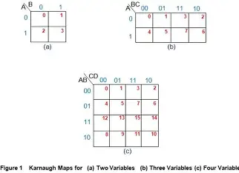
Kmap over view
Way to reduce
Logical expressions

Slide 5

Worked example and practice
Worked example:
Worked example:
Worked example: F = A!B!C!D+A!B!CD+AB!CD+AB!C!D

Slide 6
FSM explanation
FSM’s are a way to break down large problems into small *modules* to be built in SV
Shows explicitly I/O connections
Each cell needs to have at least one input and at least two outputs unless its an always state in which case its redundant
No one right answer
Not only single bit signals

Slide 7
FSM example four way intersection
Think about a major intersection, what states can the light be in?
What happens upon reset?
What happens if cars never stop coming?

Slide 8
FSM for HFT
What can the machine do?
How many clock cycles do we need to run data through our machine?
Notes:
Idle Buy Sell some states to interpret data

Slide 9
Multi threading (kind of)
Typically called pipelined for digital logic
Running multiple calculations at the same time through different parts of the machine
SV does this for us when it can

Slide 10
Show some SV if we have time

Slide 11
Trading data
What kinds of data are there for trading?
Unconventional data is big business
It sometimes is unethical
Notes:
Satellite images of oil tankers and parking lots
Temperature of towns pipelines run through
Data on the average weight for flights
Data on the type of people going on a cruise

Slide 12
More typical data for trading
EBITDA / EBIT
EV not to be confused with EV
Market Capitalization
Three financial statements
Options greeks

Slide 13
Look up apple stock then go to financials and other tabs

Slide 14

How to get that sweet sweet quant job
Apply soon
Put this project on your resume and *embellish*
You all were in the math club in high school and
should probably actually join in college
Networking on linkedin and via unconventional data(email spam)
Lots of companies that pay a ton also a lot that pay marginally less
Learn whatever it means to “Make me a market” and grind stats
Quant.io type sites

Slide 15
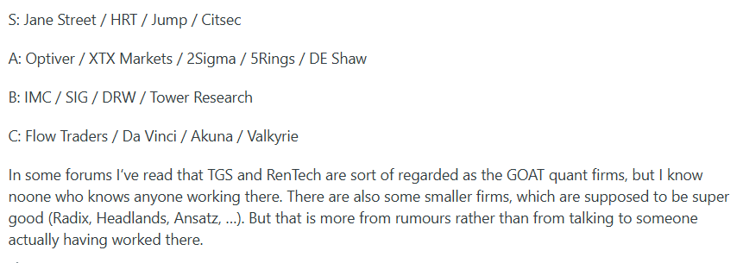
This losers opinion
Any internship in your field is a good one

